Slide 1
Git 101
Or: Git for Gits
David Muckle

Slide 2
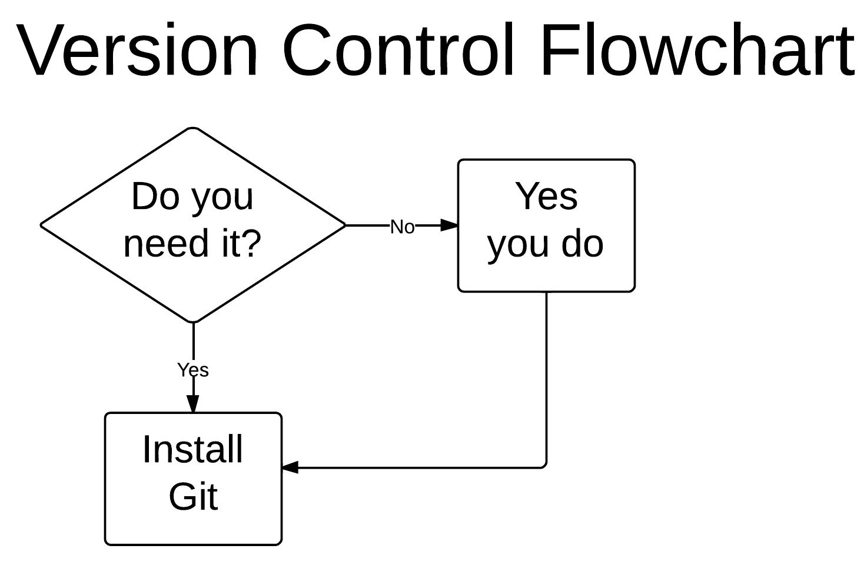

Slide 3
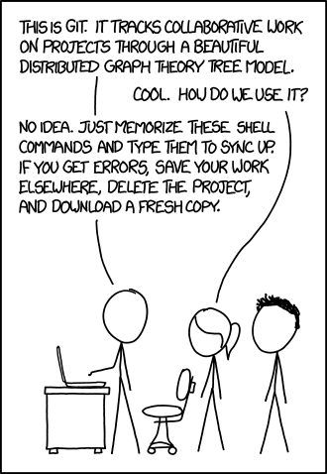
What is Git?
VCS (Version Control Software)
CVS, Mercurial, Git
Keep track of changes
Revert back to old changes
Keep multiple versions of a project
Merge versions
Synchronize projects between machines
Keep your project “in the cloud”

Slide 4
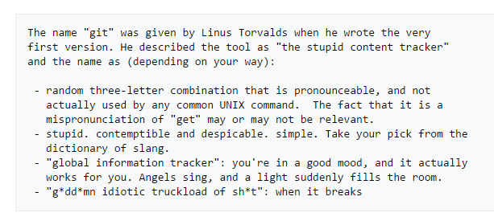


History of Git
Use in Linux development
Replacing BitKeeper
Use online
GitHub, BitBucket
Notes:
Quick slide, highlight how Git came to be and its origins.
4

Slide 5
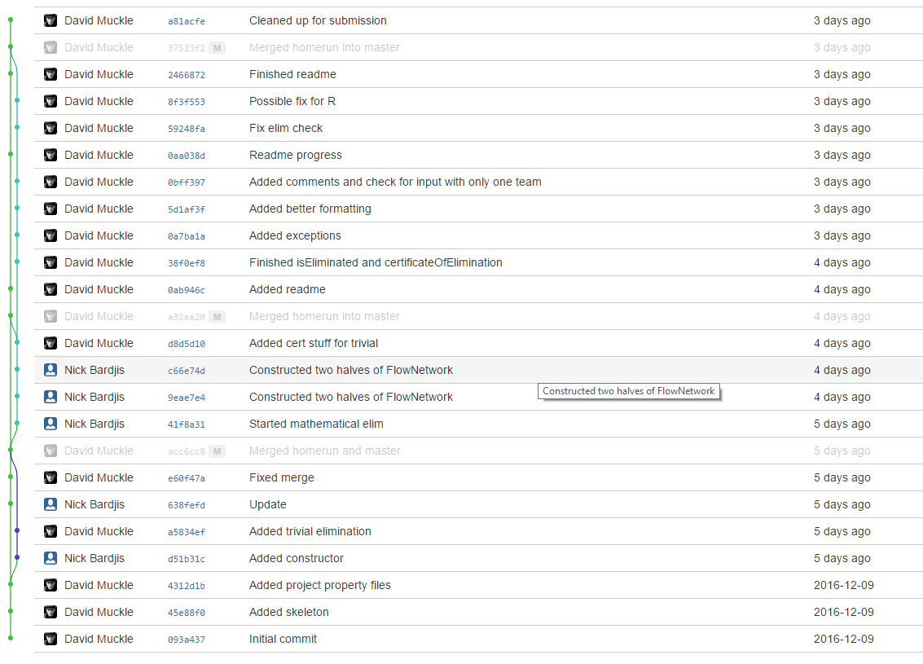
The Git Basics
git init
git clone http://example.com/repo
Use http or ssh
git add somefile.thing
git status
git commit -m ‘Comment’
git push
git pull
git branch branchname
git checkout branchname
git merge
Notes:
Break here to go through a live demonstration of each of these commands.
5

Slide 6
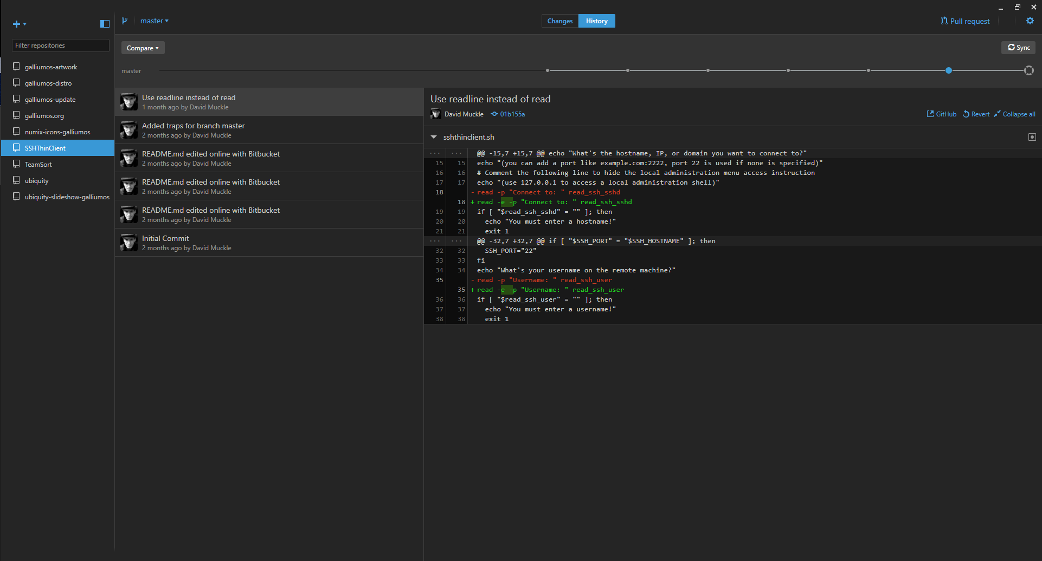
Graphical Clients
Integration with IDEs
Eclipse, Netbeans, IntelliJ
Standalone Clients
GitHub Client, Atlassian SourceTree, Git GUI
Notes:
Stress that learning how to use Git on a command line is a must before using graphical clients, as if something screws up on the client one can fall back to the command line.
6

Slide 7
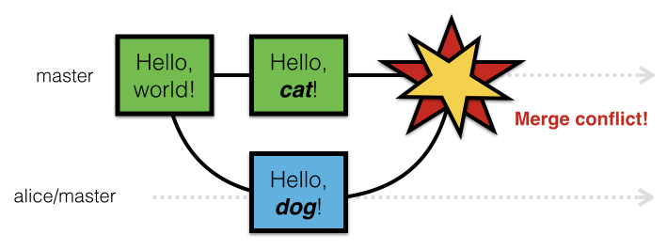
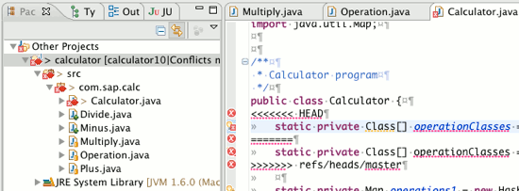
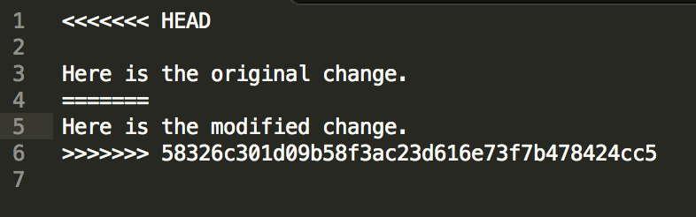
What to do if Git breaks
Notes:
A situation that many people might run into, hence a few slides on it.
7

Slide 8

Notes:
Self explanatory.
8

Slide 9
Resolving Merge Conflicts
Stay calm
Read the marked changes
Talk with your partner(s)
Figure out what to keep
Edit accordingly
Push changes
Notes:
Live demonstration of resolving a merge conflict here. Also highlight that if worse comes to worse, making a backup of code and nuking the local repo is fine too.
9

Slide 10
Using with your Clark CS Account
Create a repository on system
Commit changes
On local computer, git clone ssh://username@csgateway.clarku.edu/home/username/pathtorepo
Won’t work with pair programming
Notes:
Because people really don’t use this resource enough!
10

Slide 11
Suggested Setup for Pair Programming
Use BitBucket
Create repository with private access
Add members to repository
OR
Create team with partner
Create repository under team
Notes:
Basically what this whole presentation is for. Make note that this is only one of many ways to do this.
11

Slide 12
Can I use Git for other things?
Absolutely!
Essays
Cover letters
Image editing
Recipes
Program settings (dotfiles)
This PowerPoint
Notes:
Because Git is really cool and can be used for a whole bunch of things.
12

Slide 13
Other Git Resources
Oh Shit, git! http://ohshitgit.com
Gitless http://gitless.com/
Github
Notes:
13

Slide 14
Go forth and Commit!

